Slide 1
Career Development: #OwnIt
People Strategy
April 2017

Slide 2
agenda
01 | Learning Objectives
02 | Overview of Career Development
03 | 4 Steps of Career Development
04 | Building Your Individual Development Plans
05 | Resources & Wrap Up
06 | Q&A

Slide 3
Career development: Learning Objectives
Understand how experience, exposure, and education combine to build an individual development plan.

Slide 4
career development is not…
A Promotion
A Life Plan
Specific to MassChallenge
A One-Time Effort

Slide 5
how do people really advance their careers?
Identifying your personal professional goals
starts with your big picture.
Fulfilling your professional goals starts
with the organization’s big picture.
Professional
Goal
Department/ Team
Goals
Organizational Goals
Personal Mission / Vision
Career Aspirations
Professional Goals
Buy in - Visibility - Credibility - Support
Notes:
While identifying how you want to grow and who you want to be often starts with your big professional goals, figuring out how to build credibility and relationships to reach these goals can be more effective considering the environment you’re in.
This is how you can progress in your career and involve the people who will give you support, credibility, and visibility.

Slide 6
01 | Learning Objectives
02 | Overview of Career Development
03 | 4 Steps of Career Development
04 | Building Your Individual Development Plans
05 | Resources & Wrap Up
06 | Q&A

Slide 7
Career development: The 4 Steps
Define your North Star
Deconstruct the North Star into the 3 E’s:
Experience & Skills (Experience)
Competencies (Education)
Networking Opportunities (Exposure)
Build an Aligned Annual Plan
Review and Revise Regularly
Monthly – am I on track?
Quarterly - where do I need help?
Semi-Annually – do I need to make revisions?

Slide 8
Take 3 minutes now to define your north star

Slide 9
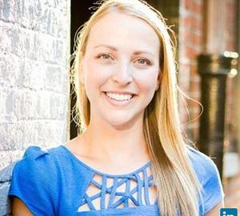
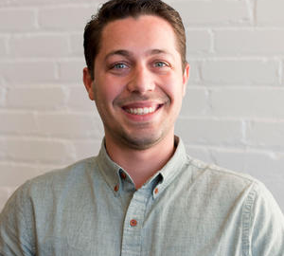
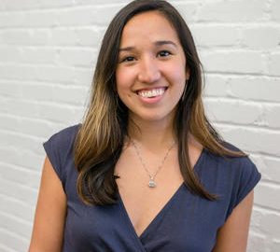
example
MC Need: Strong relationships for future
+ Career Aspiration: Ambassador = Opportunity: build relationships across entities and facilitate collaboration
MC Need: Mentor engagement & community
+ Career Aspiration: Entrepreneur, Pet Savior = Opportunity: build relationships with mentors and understand the value they offer our startups
MC Need: Speakers, learning & dev training
+ Career Aspiration: Motivational Speaker = Opportunity: speak publicly and build MC brand/ community relationships

Slide 10
Career development: start by de-constructing
North Star
Education
Experience
Exposure
Experience – 70%
Stretch Assignments
Job shadowing
Volunteering Opportunities
Active Participation
Exposure – 20%
Conferences & Seminars
Executive Presentations & All Hands Meetings
Being a mentor & mentee
Skip Level Meetings
Education – 10%
In-house Learning & Development Opportunities
Continuing Education
Independent Research & reading

Slide 11
Deconstructing the north star: an example
Career Goal:
To become a thought leader amongst People Strategy professionals.
Experience
Create New & Innovative Ways to Engage the Workforce
Publish Thought Leadership Articles & Blogs
Work closely with the C-suite to understand Corporate Objectives and align People Strategy
Exposure
Discuss People Strategy with the Board of Directors and/or Advisors
Create a network of leading People Strategy professionals
Education
Participate in cutting-edge People Strategy seminars & continuing ed opportunities
Engage the local Boston Tech community to learn from each other

Slide 12
Career development: outcomes
#workit
TAKE 15 MINUTES TO WORK THROUGH YOUR INDIVIDUAL DEVELOPMENT PLAN

Slide 13
Individual development plan: an example
Goal # 1 | Example Text
Developmental goals for the coming year | Create 12 Useful & Aligned L&D Opportunities
Relationship of goal to the organization’s goals | #3 – Invest in Talent!
Knowledge, skills, abilities to be developed | Create new & innovative ways to engage Work closely w/C-Suite
Action Items | 12 L&D Opportunities
Success Measures | Avg Rating of 4+ Strong attendance records Value from ROI study
Date for completion | On- going, but 12/31/2017

Slide 14
Career development: the full cycle
Career Goal (North Star)
Work & Life Experiences
Skills/Competencies
Networking Opportunities
Career Growth

Slide 15
Career development: tools available
Values
Motivations
Priorities
Predictive Index
FREE for all MassChallenge employees!
Behavioral Assessment that evaluates workplace results
MBTI
FREE for anyone on the internet
Behavioral Assessment that evaluates broad trends in all facets of life
StrengthsFinders
Focuses on areas of natural ability and how to leverage that
$15 per Test

Slide 17
Notes:
Better coupling with manager and overall MC goals
Less emphasis on the self-ish component and more focus on the collaborative and aligned employee
More emphasis on SMART
MC Goals → Department → Individual
RAPID for goal setting → manager has to give input and sign off and vice versa for your department’s goals
Top down but also bottom up to identify professional dev goals
Email to managers to understand that their staff are going to be working on this and these are our expectations
We are going to be implementing goals in the new HR system: this is what john’s view is going to be
Director goals

