Slide 1
MC training: Interviewing
Select the best.
Notes:
Welcome to our interview training!

Slide 2
Why? 2017 MassChallenge Goal: build a team prepared to expand our mission throughout the world
Notes:
You may be wondering, why is this even important? Why am I sitting here?
This is why: one of our organizational objectives is to build a team prepared to expand our mission across the world. This requires some aggressive hiring.

Slide 3
Training Objective: To understand and execute objective interviewing in order to hire the best person for the job, every time.
Notes:
Thus, our objective for today is to understand how to objectively interview in order to hire the best person for the job, every time.

Slide 4
Takeaways
6 Steps for Successful Interviewing & How to Avoid Unconscious Bias
Interviewing Competencies and Questions
How to Create an Effective Interview Plan
How to Build an Insightful Rubric
Notes:
By the end of this training seminar, you will know:
6 Steps for Successful Interviewing & How to Avoid Unconscious Bias
Interviewing Competencies and Questions
How to Create an Effective Interview Plan
How to Build an Insightful Rubric

Slide 5
Agenda
Sample Interview
Team Interview Planning
Sample Interview Plan
Q&A / Review
Session Feedback
6 Keys to Successful Interviewing
Notes:
We will start with a sample interview activity you will complete in pairs. Then we will review the 6 Keys to Successful Interviewing.
You will review a Sample Interview Plan and Rubric and then start working on your own Team Interview Plan.
Lastly, we will have Q&A to answer your questions, review the key takeaways, and collect feedback on the training.

Slide 6
Activity Resources
Interview Script
Interview Plan & Rubric Instructions/ Template
Sample Interviewing Competencies/ Questions
Notes:
Please make sure you have each of the following. If not, you may grab one up at the front.

Slide 7
interview
Partner up and read through the interview script. Write your responses to the questions.
Notes:
Please partner up. You have 5 minutes to read through the interview script and write your responses to the questions. Then we will review.
[Timer for 5 min.]
5 minutes have passed.
Let’s start with the first question. Can we have a pair tell us what they believe are the implications of asking unscripted questions?
[Gather 1-3 responses before changing slides.]

Slide 8
Q1 Discussion: What are the implications of asking unscripted questions?
Does it add value?
Could it invite unconscious bias?
Notes:
When asking questions, consider: does it add value? Could it invite unconscious bias?
While “Did you watch the game?” sounds like an innocuous question to relate and make someone feel comfortable, it can invite unconscious bias depending on if they respond in a way you relate to or not.
Unscripted questions can impact the way we perceive candidates.
Plus, if we ask each candidate different questions, we cannot evaluate them objectively or compare them to one another. Would it be fair to be evaluated on your appreciation of sports? Or evaluated on a different set of questions than someone else? [Next slide]

Slide 9
Consistency is king.
Same questions.
Same order.
Every time.
Notes:
When asking questions, remember: consistency is king.
To avoid unconscious bias, ask the same questions in the same order, every time.

Slide 10
Q2 & Q3 Discussion: What makes a good answer?
Results
Context
Actions
Notes:
Now for question 2: Let’s hear from a few groups what they believe makes a good answer.
[Gather 1-2 responses, then Click for animation]
Great answers will have three components:
Context: why is this important or relevant to the interview?
Actions: what did you/your team do to directly impact this situation and create results?
Results: what actually resulted from your actions? Was it the right choice? Could it have been better?
Did this first response have all components?
How could it have been stronger?
When the interviewee fails to answer one of these areas, you may ask pertinent clarifying questions without necessarily going “off-script.” You are still asking the same question, but you need all the information.
For the second question, what were the context, actions, and results?

Slide 11
Q4 Discussion: What are implications of discussing the candidate?
Discussing candidates as a team = GREAT. Discussing candidates before everyone has submitted evaluations individually = group think, confirmation bias, etc.
Notes:
Onto the last question: what are implications of discussing the candidate?
[Gather 1-2 responses, then Click for animation.]
It is a good practice to debrief and discuss the candidate as a team to include multiple perspectives. However, this should happen after all evaluations have been submitted. Discussing the candidate beforehand invites group think, confirmation bias, and other pressures that skew our objective assessment of a candidate.
Rather than find the best candidate for the role, we start to look for the best candidate that aligns with the biggest influencer’s perspective.

Slide 12
6 keys for success
Notes:
In that scenario, you saw a few ways that unconscious bias can sneak into the interviewing process. Now, we will review 6 keys for successful and objective interviewing.

Slide 13
6 keys to successful interviewing
Before the Interview
During the Interview
CAR Responses.
Rubric.
After the Interview
Plan.
Consistency is king.
Don’t Ask.
Have an interview plan and defined interview roles and a rubric for each interviewer.
Always use the same questions in the same order. Switching the script can compromise objectivity.
Look for answers with Context, Actions, & Results.
Notes.
Take notes – your memory is imperfect.
Use a rubric and score each candidate against the competency and question while you are with them (they shouldn’t be aware of this).
Don’t ask for other opinions until you’ve finished your evaluation
Notes:
Successful and objective interviewing begins before the interview takes place. By creating an interview plan with defined roles and a rubric for each interviewer, you align the team on important candidate criteria and give each person a focus.
During the interview you need to be consistent as discussed. Furthermore, pay attention to their responses: do you have all the information? Is their answer demonstrate a clear and logical transition from context to actions to results?
Also remember that your memory is imperfect and it is imperative to make meaningful notes so you can evaluate accurately.
Using your rubric that your hiring manager and/or team created for the role, you ensure that you can compare candidates against meaningful criteria to find the best candidate.
Lastly, wait to discuss the candidate with anyone until all evaluations are in to avoid groupthink, peer pressure, etc.

Slide 14
Sample
interview plan
Grab the sample interview plan and rubric.
Notes:
Now we will review a sample interview plan and rubric. Please grab one from the front.

Slide 15
RAPID for interview planning
Recommender = screener
Approver = executive team member (reserved for specific roles)
Performers = interviewers (including employee's future manager)
Input Providers = interviewers
Deciders = hiring manager (usually director or above, except for interns)
Notes:
We create an interview plan for each role. While this is an upfront investment, it rarely changes after it is created and ensures that you are selecting the best fit.
We start with a RAPID. In this case, the
Recommender = screener
Approver = executive team member (reserved for specific roles)
Performers = interviewers (including hiring manager) Input Providers = interviewers Deciders = hiring manager
Note that you usually do not have an Approver unless it is a very high-level job.

Slide 16
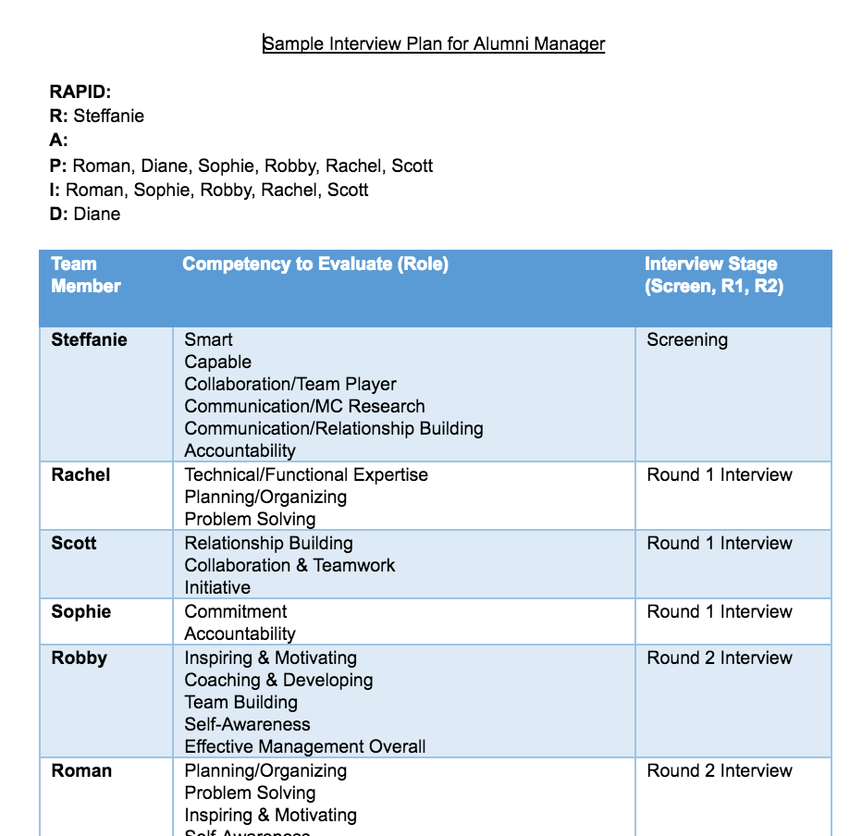
Sample plan: Alumni Manager role
Fill in team members from RAPID
Choose important competencies and most qualified team member to evaluate each
Assign interview stages
Screeners should interview for foundational competencies
Notes:
Next, you translate this RAPID into your sample plan. All team members from the RAPID go in the left hand column.
Then, you choose important competencies and determine the most qualified team member to evaluate each. You place these competencies in the middle column.
Lastly, you note which interview stage is most appropriate for each interview.
You will find recommendations on your ‘Sample Interview Competencies and Questions’ sheet. These questions and competencies are not the be-all-end-all but rather a starting point for your team. We encourage you to ask questions and evaluate competencies that help you/your team determine the best fit for the role.

Slide 17
Sample Rubric: Screening for the Alumni Manager role
Task Description: Phone Screen a Candidate for the Alumni Program Manager position
Competency | weight | Outstanding | Excellent | Good | Marginal
Collaboration/ Team work | 25% | Highly collaborative with no less than 3 examples of successful teaming Addresses team issues with the person directly, timely, and eloquently | Strong collaborator with at least 2 examples of successful teaming Addresses team issues with the person directly, timely, and politely | Understands that teamwork is important, but may not have specific examples May miss being direct, timely, or struggle in communication on tough situations | Doesn’t value teamwork over independent responsibilities Struggles to communicate or resolve teaming issues effectively
Communication/ MC Research | 15% | Shows in-depth understanding of MC 3-4 MC specific references made throughout the conversation | Shows understanding but lacks depth 2 MC business concepts presented | Shows basic understanding of topic One underlying concept presented | Shows little understanding of topic No underlying concepts presented
Communication/ Relationship Building | 25% | Open ended questions Questions designed to draw out information from person interviewing | Some open ended questions Some questions were designed to draw out information from person interviewing | Few questions were open ended Few questions were designed to draw out information from person interviewing | All questions are yes/no Questions were not designed to draw out information from person interviewing Said “like” or “um” 15 times or more
Accountability | 15% | Can clearly articulate the importance of learning/failure Provides 3-4 examples of valuable learning and ownership | Understands the importance of learning/failure Provides 1-2 examples of valuable learning and ownership | Few questions are asked in logical order Few questions are designed to build on previous questions | Questions are not in logical order Questions are not designed to build on previous questions
Smart | 10% | Questions asked in logical order Questions are designed to build on previous questions or context provided | Most questions asked in logical order Some questions are designed to build on previous questions or context provided | Few questions are asked in logical order Few questions are designed to build on previous questions or context provided | Questions are not in logical order Questions are not designed to build on previous questions or context provided
Capable | 10% | Highlights 5 unique instances where they executed well and achieved results | Highlights 3-4 unique instances where they executed well and achieved results | Highlights 1-2 unique instances where they executed well and achieved results | No results discussed
Notes:
Once your interview plan is complete, you can create your interview rubric. In the previous interview plan, Steffanie was screening the alumni manager candidates.
Here is Steffanie’s sample screening rubric for the alumni manager role. As you can see, the competencies she was responsible for in the middle column of the plan are now on the left column.
Along with the team, she selected weights for each competency and filled in precise criteria for each rating. You can translate this scale to a 1-4 scale that helps your team members and the hiring manager get a quick overview of the candidate.
It is important to make sure your team is agrees on the distinctions between a marginal and outstanding answer. Otherwise, you can get inconsistencies or evaluate criteria that may not matter while leaving out important factors.
For example, some people may believe it is valuable to consider how many times a candidate says like or um. In a sales role, this could have a big impact on perceived professionalism. However, if nobody knows to look for that, the hiring manager may lack important information.

Slide 18
Team interview planning
Grab your interview plan.
Notes:
Your turn!
Grab your blank interview plan and rubric. Over the next 10 minutes, you will work with your team to build an interview plan for a specific role.

Slide 19
Build an interview plan
Find your team members or join a team.
Select a position you want to hire.
Fill out the plan: (8m)
Fill in RAPID and select interviewers for each stage
Select competencies for each interviewer
Build your rubric for screening: (8m)
Fill in the competencies in the screening stage
Agree on weights for each competency
Agree on criteria for each rating
Notes:
First, find your team members or join another team.
Next, select a position you want to hire in 2017.
You will then have 8 minutes to complete the plan and 8 minutes to work through your rubric for the screening portion of the plan.
Lastly, create a work product or case study to help you evaluate the candidate.

Slide 20
Share out
Notes:
Would a team like to share out their interview plan and how they chose the team members/competencies?
[Call on a team if no volunteers.]

Slide 21
Q&A
Notes:
What questions do you have?

Slide 22
Review
Notes:
What are 3 keys to successful interviewing?
Before the Interview
Plan.
During the Interview
Consistency is king.
CAR Responses.
Notes.
Rubric.
After the Interview
Don’t Ask.

Slide 23
Training Objective: To understand and execute objective interviewing in order to hire the best person for the job, every time.
Notes:
To review, our objective is that you walk out knowing how to objectively interview and empowered to hire the best person for the job, every time.

Slide 24
Takeaways
6 Steps for Successful Interviewing & How to Avoid Unconscious Bias
Interviewing Competencies and Questions
How to Create an Effective Interview Plan
How to Build an Insightful Rubric
Notes:
You should have all of these hand outs. We will send these and more—including best practices for logistics and evaluating candidates—in a follow up email.

Slide 25
Action items: 1. Create an interviewing plan for the roles you are hiring for in 2017. 2. Create a rubric for each competency you are evaluating. (You can re-use these in your interview plans!)
Notes:
Moving forward, you should:
Create an interviewing plan for the roles you are hiring for in 2017.
Create a rubric for each competency you are evaluating. (You can re-use these in your interview plans!)

Slide 26
Please provide Feedback so we can improve
Thank you!
Notes:
Thanks so much for participating – please provide feedback so we can improve this and future training sessions.

